Slide 1
Implementation of Demand Paging
Akshaya Jeyaramsankar

Slide 2
Virtual Memory
A computer can access more memory than what is physically installed on the system.
This extra memory is a section of a hard disk that’s set up to emulate (replicating the behaviour of the original system) the computer’s RAM. This memory is called Virtual Memory.
Virtual Memory serves two purposes:
It allows us to extend the use of physical memory by using disk.
It allows us to have memory protection as each virtual address is translated to a physical address.

Slide 3
Paging in OS
Paging is a memory management scheme by which a computer stores and retrieves data from secondary storage for use in main memory.
In this scheme, the operating system retrieves data from secondary storage (example, a disk) in same size blocks called pages.
Paging eliminates the need for contiguous allocation of physical memory.

Slide 4
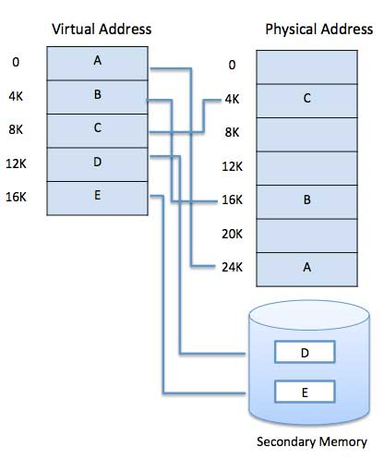
A memory management unit, or MMU, is built into the hardware.
The mapping from virtual to physical address is done by the MMU and this technique is known as paging technique.
A basic example is shown −

Slide 5
Demand Paging
The process of loading the page into memory on demand (whenever page fault occurs) is known as demand paging.

Slide 6
Steps Involved in Demand Paging
If CPU try to refer a page that is currently not available in the main memory, it generates an interrupt indicating memory access fault.
The OS puts the interrupted process in a blocking state. For the execution to proceed the OS must bring the required page into the memory.
The OS will search for the required page in the logical address space.
The required page will be brought from logical address space to physical address space. The page replacement algorithms are used for the decision making of replacing the page in physical address space.
The page table will updated accordingly.
The signal will be sent to the CPU to continue the program execution and it will place the process back into ready state.

Slide 7
Page Fault
A page fault happens when a running program accesses a memory page that is mapped into the virtual address space, but not loaded in physical memory.
Since actual physical memory is much smaller than virtual memory, page faults happen. In case of page fault, Operating System might have to replace one of the existing pages with the newly needed page. Different page replacement algorithms suggest different ways to decide which page to replace. The target for all algorithms is to reduce the number of page faults.

Slide 8
Page Replacement Algorithms
First In First Out (FIFO)
Least Recently Used (LRU) Algorithm
Least Frequently Used (LFU) Algorithm
Most Frequently Used (MFU) Algorithm
Optimal Page Algorithm

Slide 9
First In First Out (FIFO) Algorithm
In this algorithm, the operating system keeps track of all pages in the memory in a queue, the oldest page is in the front of the queue. When a page needs to be replaced page in the front of the queue is selected for removal.

Slide 10
Least Recently Used (LRU) Algorithm
Page which has not been used for the longest time in main memory is the one which will be selected for replacement.
Easy to implement, keep a list, replace pages by looking back into time.

